Slide 1




Slide 2

TEST TIME ON PROBABILITY
URL:https://forms.gle/mTp7YjUuXvvwHvgf6
QR CODE:

Slide 3

QUADRATIC EQUATION

Slide 4
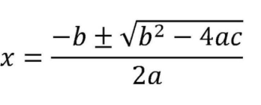
An equation of the form ax² + bx + c = 0, where a > 0 and a, b, c are real numbers, is called a quadratic equation.
The numbers a, b, c are called the coefficients of the quadratic equation.
A root of the quadratic equation is a number a (real or complex) such that aa² + ba + c = 0

Slide 5
To solve a quadratic equation you can use two methods:
1. Using a standard formula 2. Factorization method
1. Using a Standard Formula
Any quadratic equation can be solved easily and quickly by using this method. If
the quadratic equation is of the type ax² + bx + c = 0, then the solution will be
x = -b ± √(b² -4ac)/2a.
Notes:
Explanation:
In the school,
Boys = 4/7 × 1554 = 888
Girls = 3/7 × 1554 = 666
After 30 days, Girls = 666 + 30 = 696 If x boys leave the school, then, According to the question,
(888– x)/ 696 = 7/6
(888– x)/ 116 = 7
888 – x = 116 × 7 = 812
x = 888 – 812 = 76

Slide 6
2. Factorization Method
In factorization, you need to find the factors of the given terms.
For example, factors of 8 are 1, 2, 4, and 8 Similarly factors of 12 are 1, 2, 3, 4, 6, and 12. Thus you can use this method only when the terms given to you can be factorized. This method is usually quicker than the other method.
The other basic concepts you need to remember while solving quadratic
equations are:
1. Nature of roots 2. Sum and product of the roots 3. Forming a quadratic equation

Slide 7
If the product of roots of the equation x² – 3(2a + 4)x + a² + 18a + 81 = 0 isunity,
then a can take the values as
Explanation:
The product of the roots is given by:
(a² + 18a + 81)/ 1.
Since product is unity we get: a² + 18a + 81 = 1
Thus, a² + 18a + 80 = 0
Solving, we get: a = –10 and a = – 8.
.
Notes:
Explanation:
Tickets of type A = 3x
Tickets of type B = 2x
Tickets of type C = 5x
According to the question,
(3x × 1000 + 2x × 500 + 5x × 200)
= 2.5 × 10000000
30x + 10x + 10x = 250000
50x = 250000
x = 5000

Slide 8
Question: 01
For what value of c the quadratic equation x² – (c + 6)x + 2(2c – 1) = 0 has sum
of the roots as half of their product?
5
–4
7
3
Answer: C

Slide 9
Question: 01
Explanation: 01
For what value of c the quadratic equation x²– (c + 6) x + 2( 2c – 1) = 0 has sum
of the roots as half of their product?
Explanation:
(c + 6) = 1/ 2 × 2( 2c – 1) fi c + 6 = 2c – 1 fi c = 7

Slide 10
Question: 02
Question: 02
Two numbers a and b are such that the quadratic equation ax²+ 3x + 2b = 0 has
– 6 as the sum and the product of the roots. Find a + b.
2
–1
1
–2
Answer: B

Slide 11
Question: 02
Explanation: 02
Two numbers a and b are such that the quadratic equation ax²+ 3x + 2b = 0 has
– 6 as the sum and the product of the roots. Find a + b.
Explanation:
-3/ a = –6 fi a = ½,
2b/ a = –6 and a = ½
Gives us b = –1.5.
a + b = –1.

Slide 12
Question: 03
Question: 03
If a=√(7+4√3), what will be the value of (a+1/a)?
7
4
3
2
Answer: b

Slide 13
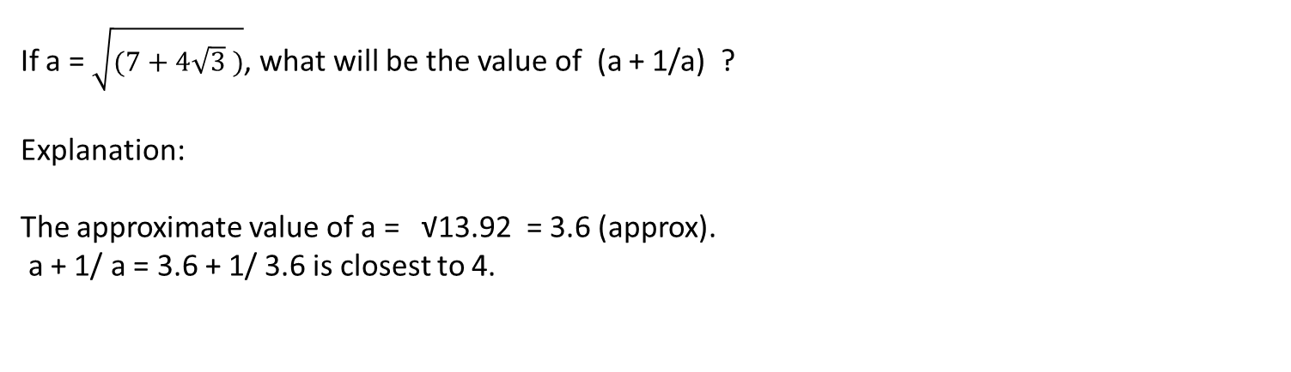
Question: 03
Explanation: 03

Slide 14
Question: 04
Question: 04
If x² + ax + b leaves the same remainder 5 when divided by x – 1 or x + 1 then
the values of a and b are respectively
0 and 4
3 and 0
0 and 3
4 and 0
Answer: D

Slide 15
Question: 04
Explanation: 04
Explanation:
Remainder when x² + ax + b is divided by x – 1 is got by putting x = 1 in the expression.
Thus, we get.
a + b + 1 = 5 and
b – a + 1 = 5
fib = 4 and a = 0

Slide 16
Question: 05
Question: 05
The set of real values of x for which the expression x² – 9x + 20 is negative is
represented by
4 < x < 5
4 < x < -5
x < 4 or x > 5
–4 < x < 5
Answer: A

Slide 17
Question: 05
Explanation: 05
The set of real values of x for which the expression x² – 9x + 20 is negative is
represented by
Explanation:
The roots of the equation x² – 9x + 20 = 0 are 4 and 5.
The expression would be negative for 4 < x < 5.

Slide 18
Question: 06
Question: 06
Find the number of solutions of a³ + 2^{a+1} = a⁴, given that n is a natural number
less than 100.
0
1
2
3
Answer: B

Slide 19
Question: 06
Explanation: 06
Explanation:
In order to think of this situation, you need to think of the fact that “the cube of a
number + a power of two” (LHS of the equation) should add up to the fourth
power of the same number.
The only in which situation this happens is for 8 + 8 = 16 where a = 2 giving us
23 + 23 = 24.
Hence, Option (b) is the correct answer.

Slide 20
Question: 07
Question: 07
The number of positive integral values of x that satisfy x³ – 32x – 5x² + 64 £ 0
is/are
4
5
6
More than 6
Answer: D

Slide 21
Explanation: 07
The number of positive integral values of x that satisfy x³ – 32x – 5x² + 64 £ 0 is/
are
Explanation:
The values of x, where the above expression turns out to be negative or 0 are x =
2, 3, 4, 5, 6, 7 or 8.
Hence, Option (d) is correct.

Slide 22
Question: 08
Question: 08
Find the positive integral value of x that satisfies the equation x³ – 32x – 5x² + 64 = 0.
5
6
7
8
Answer: D

Slide 23
Question: 08
Explanation: 08
Find the positive integral value of x that satisfies the equation x³ – 32x – 5x² + 64= 0.
Explanation:
The value of the LHS would become 512 – 256 – 320 + 64 = 0 when x = 8.

Slide 24
Question: 09
For what value of b and c would the equation x² + bx + c = 0 have roots equal to
b and c.
(0, 0)
(1, –2)
(1, 2)
Both (a) and (b)
Answer: B

Slide 25
Explanation: 09
For what value of b and c would the equation x² + bx + c = 0 have roots equal to
b and c.
Explanation:
Solve using options.
It can be seen that at b = 0 and c = 0 the condition is satisfied.
It is also satisfied at b = 1 and c = –2.

Slide 26
Question: 10
Question: 10
The sum of a fraction and its reciprocal equals 85/ 18. Find the fraction.
2/6
2/3
2/9
4/9
Answer: C

Slide 27
Explanation: 10
The sum of a fraction and its reciprocal equals 85/ 18. Find the fraction.
Explanation:
2/ 9 + 9/ 2 = 85/ 18.

Slide 28
Question: 11
If the common factor of (ax² + bx + c) and (bx² + ax + c) is (x + 2) then
a = b, or a + b + c = 0
a = c, or a + b + c = 0
a = b = c
b = c, a + b + c = 0
Answer: A

Slide 29
Question: 11
Explanation: 11
If the common factor of (ax² + bx + c) and (bx² + ax + c) is (x + 2) then
Explanation:
Using x = –2,
we get 4a – 2 b + c = 4 b – 2a + c = 0.
Thus, a = b and a + b + c = 0.

Slide 30
Question: 12
Question: 12
If f(x) = x² + 2x – 5 and g( x) = 5x + 30, then the roots of the quadratic equation
g[f(x)] will be
– 1, –1
2, –1
–1 + √2 , –1 – √2
1, 2
Answer: A

Slide 31
Question: 12
Explanation: 12
If f( x) = x² + 2x – 5 and g(x) = 5x + 30, then the roots of the quadratic equation
g[f (x)] will be
Explanation:
g(f((x) = 5x² + 10 x + 5
Roots are – 1 and –1.

Slide 32
Question: 13
Question: 13
Value of the expression (x² – x + 1)/( x – 1) cannot lie between
1, 3
–1, –3
1, –3
–1, 2
Answer: D

Slide 33
Question: 13
Explanation: 13
If base is not mentioned, then always remember to take it as 10.
Hence, in the given expression, assume base as 10
We are given, [log₁₀ 2 + log₁₀ (4x + 1) = log₁₀ (x + 2) + 1]
[log₁₀ 2 + log₁₀ (4x + 1) = log₁₀ (x + 2) + 1]
[log₁₀ 2 + log₁₀ (4x + 1) = log₁₀ (x + 2) + log₁₀10]
Now, Use the product rule: log_{a}(xy) = log_{a}x + log_{a}y
[log₁₀ 2 (4x + 1)] = [log₁₀ 10(x + 2)]
(4x + 1) = (5x + 10)
4x + 1 = 5x + 10=-9

Slide 34
Question: 14
Question: 14
If the product of roots of the equation x²– 3(2a + 4)x + a² + 18a + 81 = 0 is unity,
then a can take the values as
3, – 6
10, – 8
–10, –8
–10, – 6
Answer: B

Slide 35
Question: 14
Explanation: 14
If the product of roots of the equation x² – 3(2a + 4)x + a² + 18a + 81 = 0 isunity,
then a can take the values as
Explanation:
The product of the roots is given by:
(a² + 18a + 81)/ 1.
Since product is unity we get: a² + 18a + 81 = 1
Thus, a² + 18a + 80 = 0
Solving, we get: a = –10 and a = – 8.
.

Slide 36
Question: 15
Find value of √6+(√6+(√6...
3
4
5
6
Answer: A

Slide 37
Question: 15
Explanation: 15
Let x be √6+(√6+(√6...
x = √6+(√6+(√6...
X2 = 6+ √6+(√6+(√6...
x2=6+x
x2−x−6=0
(x+2)(x−3)=0
So x=-2 or x=3
X must be greater than 0, so √6+(√6+(√6...=3

Slide 38

https://learn.codemithra.com

Slide 39




THANK YOU
+91 78150 95095
codemithra@ethnus.com
www.codemithra.com

